Slide 1
Mapping the creative industries in Mexico The Brighton Fuse Survey
Juan Mateos-Garcia
Taller de arranque: Mapa Creativo Transmedia México
8 – 9 Febrero
Ciudad de México

Slide 2
Structure
An introduction to the Brighton Fuse
Approach
Sampling frame
Questions and survey content

Slide 3
Brighton Fuse
2 year AHRC-funded project to measure the creative industries in Brighton, with a particular focus on the interaction between arts and technology
Consortium involving social scientists (SPRU & CENTRIM), arts and humanities (Brighton College of Art) and industry (Wired Sussex, an industry group).
Report perceived to be impactful, important for positioning A&H as an important contributor to economic growth through their impact on the CIs.

Slide 4
Approach
Wired Sussex membership (~800)
We didn’t have a DCMS definition when we started the project!
Online survey had to be modified and implemented via telephone due to low response rates
Survey was cognitively tested and piloted in a smaller city closer to Brighton
Creative / Digital SIC codes
Business register (7500)
Manual validation
Target (1500)
Telephone / online survey
~500 respondents

Slide 5
Example areas of interest
Combinations of Arts and Tech

Slide 6
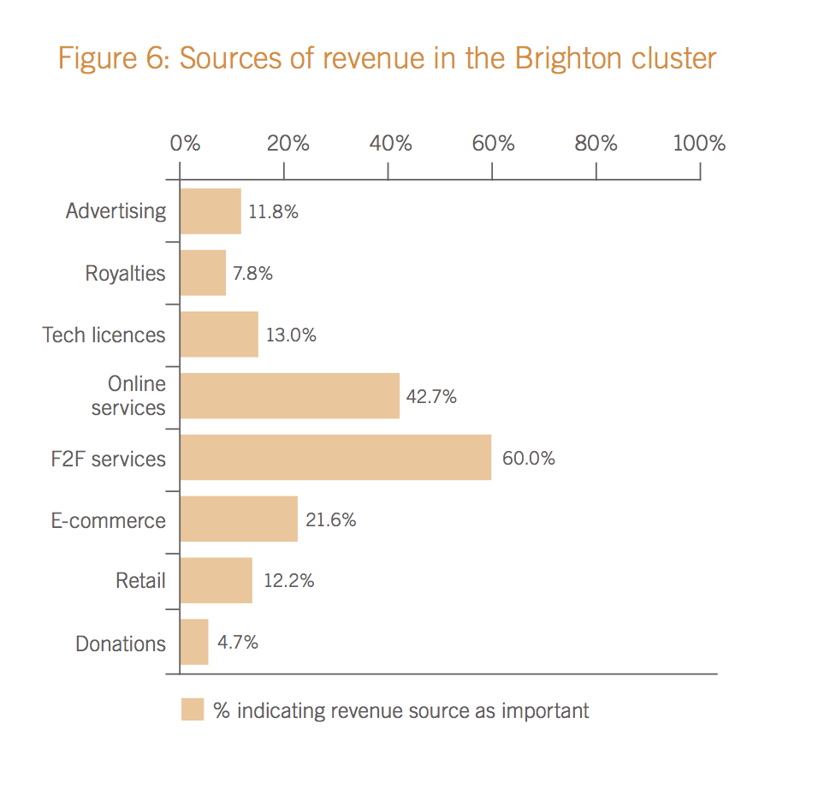
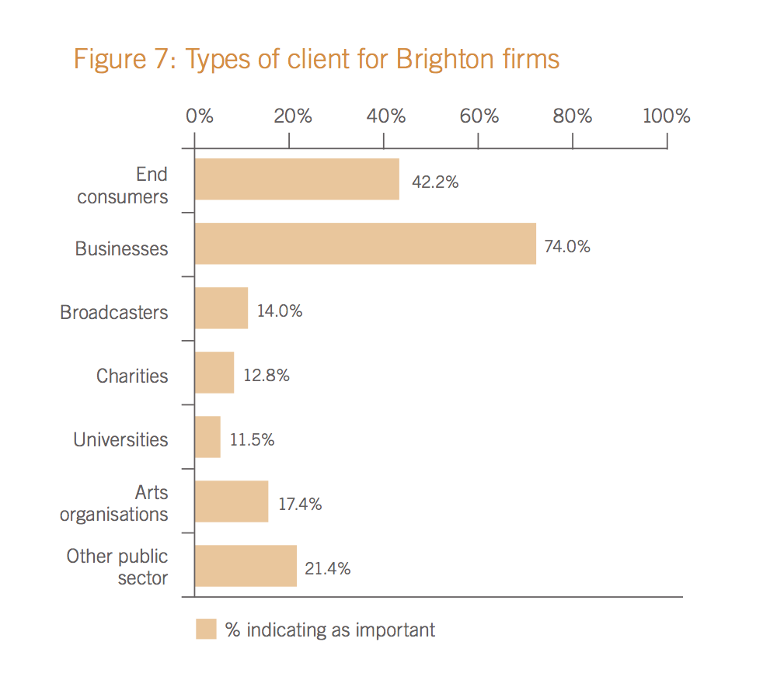
Example areas of interest
Business models and technology adoption

Slide 7
Example areas of interest
Understanding cluster development

Slide 8
Example areas of interest
And drivers / barriers to success

Slide 9
Example areas of interest
A long survey... Enabled interesting combinations

Slide 10
Juan.mateos-garcia@nesta.org.uk
@jmateosgarcia

